Slide 1


Department of Collegiate and Technical Education
Cyber Security- 20CS54I ( VI Semester)
OWASP SAMM
Computer Science and Engineering

Slide 2

Introduce OWASP SAMM – to attain software assurance maturity:
● The Software Assurance Maturity Model (SAMM) is an open framework to help organizations formulate and implement a strategy for software security that is tailored to the specific risks facing the organization. SAMM helps you:
Evaluate an organization’s existing software security practices
Build a balanced software security assurance program in well-defined iterations
Demonstrate concrete improvements to a security assurance program
SAMM provides a model for organisations to assess their current level softwar capabilities. It is not expected nor is it required that an organisation should achieve the maximum maturity level in each category.
Instead organisations are encouraged to determine the target maturity levels for each Security Practice that best fits the organisation's goals, and adapt the SAMM templates accordingly

Slide 3
Structurally SAMM defines five critical business functions:
Governance
Design
Implementation
Verification
Operations
Each business function has three security practices, each of which has two streams.
Level 0: an implicit starting point with an unfulfilled Security Practice
Level 1: an initial understanding and ad hoc
Level 2: a structured realisation with increased efficiency and effectiveness of the Security Practice
Level 3: a comprehensive mastery of the Security Practice at the scale that comes with an optimised solution.

Slide 4
How is SAMM utilized in practice?
1. Assess the organisation's current software security posture
2. Define the organisation's targets for each Security Practice
3. Define the implementation roadmap to achieve the set targets
4. Make it so! Do the necessary work to implement it all.

Slide 5
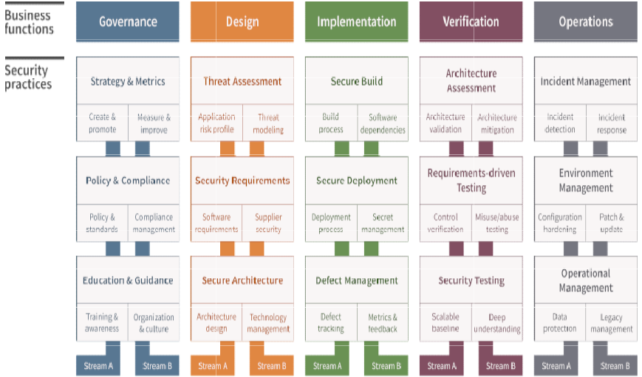

Slide 6

Thank You

